Slide 1

Weekly Review
16/03/21
Tasks
Custom Implementation : Cloth environment with SAC approach🗸
Define reward function, state, action for our use case 🗸
Conduct preliminary experiments to test the defined rewards, states, actions 🗸
Problems
Results of experiment unexpected
To-Do Items for Next Week
Conduct experiments so as to get desired results
Define more reward functions, states, actions for our use case
To-Do Later
Explore usage of intermediate testing on simulation before sim-to-real transfer
Define use-case (for different type of towels (colour, texture, etc. ) / one type )
Check the no. of episodes needed, check computational requirements

Slide 2
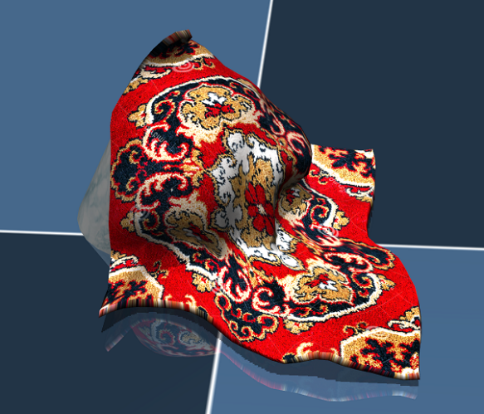
Cloth Manipulation using SAC
16/03/21
SACAgent
Observation
(64*64 img)
Action
Pick point and place point
From random pixel points
Inside segmented mask
Agent
Reward
(Overlap with goal state)
Environment (Mujoco)

Slide 3
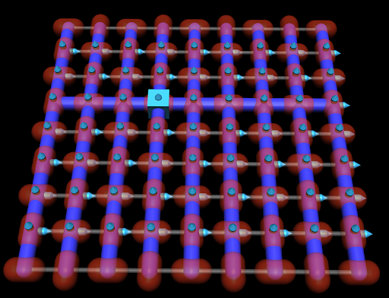
RL Problem for obtaining one flat seam
16/03/21
Goal
Obtain one flat seam
Given
Cloth in mujoco represented by 64 particles in 8*8 grid
Observations
[x,y,z] positions of 4 points adjacent to corner 1
Actions
Random [x,y] movement of corner 1
Corner 1

Slide 4
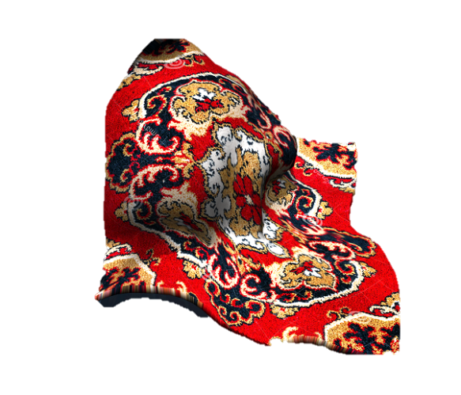
RL Problem for obtaining one flat seam
16/03/21
Goal
Obtain one flat seam -> Corner particle + 3 adjacent particles in a straight line
Reward
Join 1st point and last point
Project on x,y plane
3. Reward is proportional to :
-1 * (x,y) distance from the ideal line
Step 1
Step 2
X
X
X
X
0.3
0.3
0.3
Step 3

Slide 5
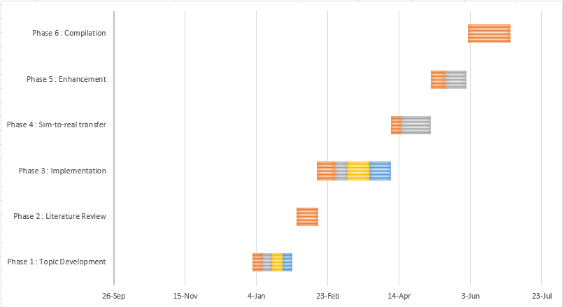
Plan
16/03/21
Phase 3 : Implementation : 52 days (mid Feb- early Apr)
Setting up the Reinforcement Learning Platform and Simulation environment : 13 days
Prepare a custom implementation taking existing states, actions, rewards : 9 days
Redefine actions and rewards for our use case : 15 days
Test the pipeline and iterate : 15 days

Slide 6
THANK YOU

